Slide 1
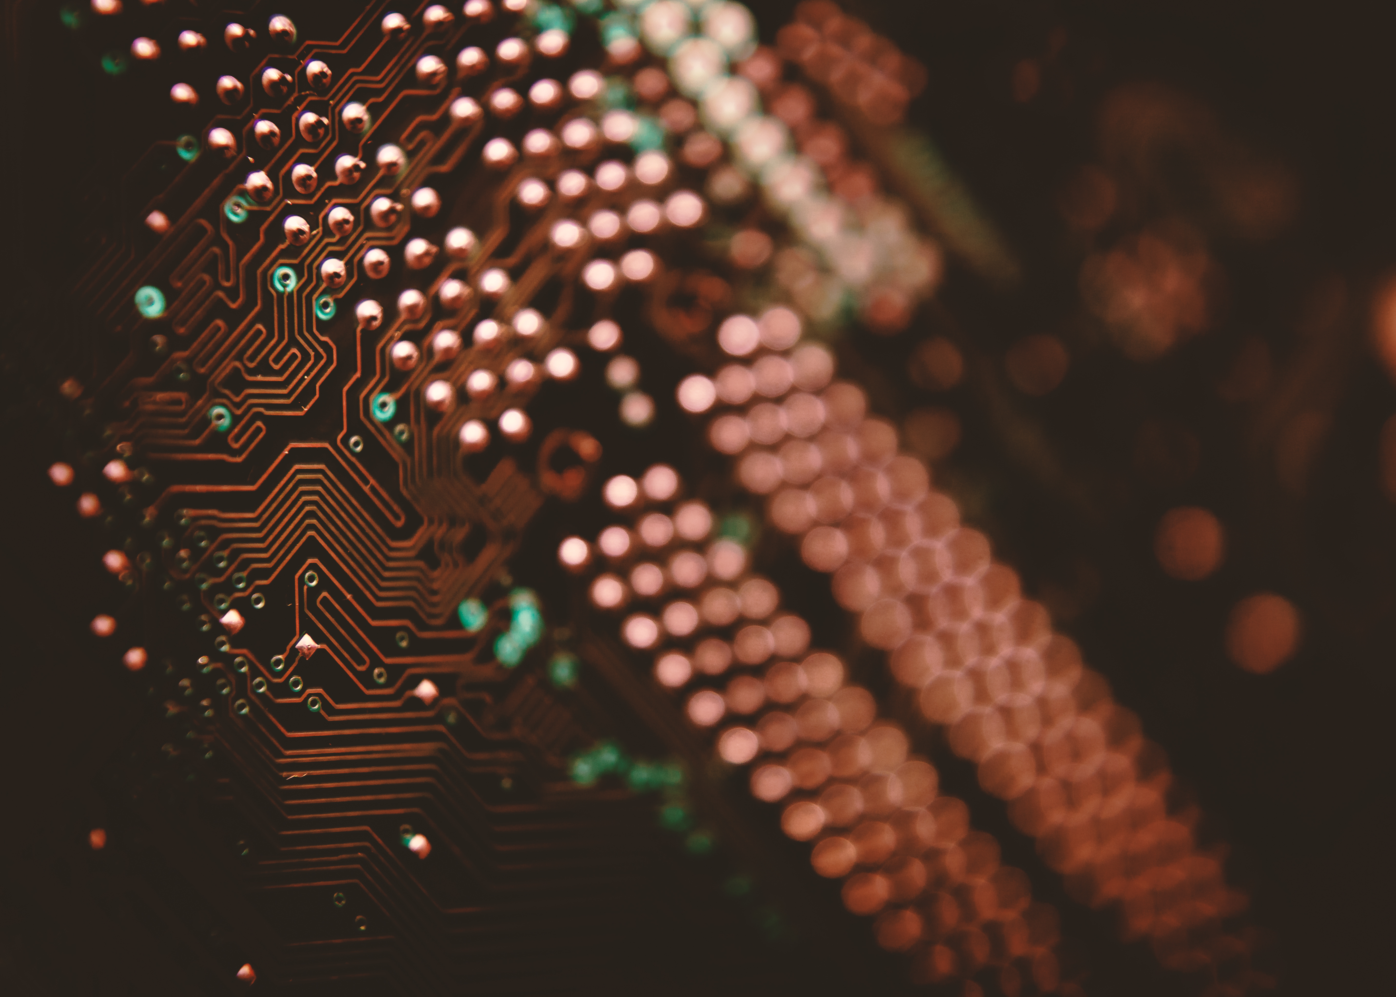
Image to sketch & Image recognition

Slide 2


Team members
1. Atik Ahmed(2100290140041)
2. Mohd Wasim(2100290140085)
3. Harshit Kaushik(2100290140068)

Slide 3
Introduction
This project is about how new technologies can be used to develop a python application that enables the user to make a sketch of any images. We will try to convert a normal photo into a sketch and also try to recognition of an image using computer vision, machine learning in a python programming language.

Slide 4
Introduction
This project make it easier for people to understand how painters create pencil drawings. This is accomplished through the use of graphical interface python tools such as tkinter, matplotlib, and others. The user can easily choose an image from their files. Then it can select the convert button. The picture has been transformed into a lovely sketch. It also help peoples to identify the image, means kinds of given image it is.

Slide 5
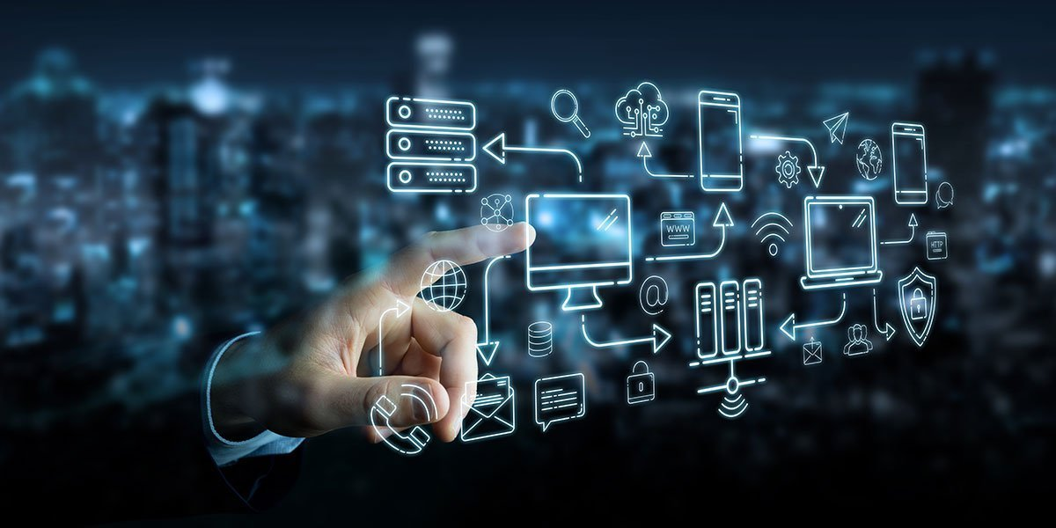
Technology used
Python
Machine Learning
Tkinter

Slide 6

Modules
1. File Selection
3. Sketch Conversion
2. Image Identification

Slide 7
Modules Description
File Selection: In this module, User can make selection of own choice of images from the folder. This module help user to easily selection of the image.
Sketch Convert: In this module, the application can be able to convert a user selected image into a beautiful sketch. The output is genearated as a new image in the form of sketch.
Image Recognition: This module has a ability to identify objects, places, people, writing and actions in digital images.

Slide 8
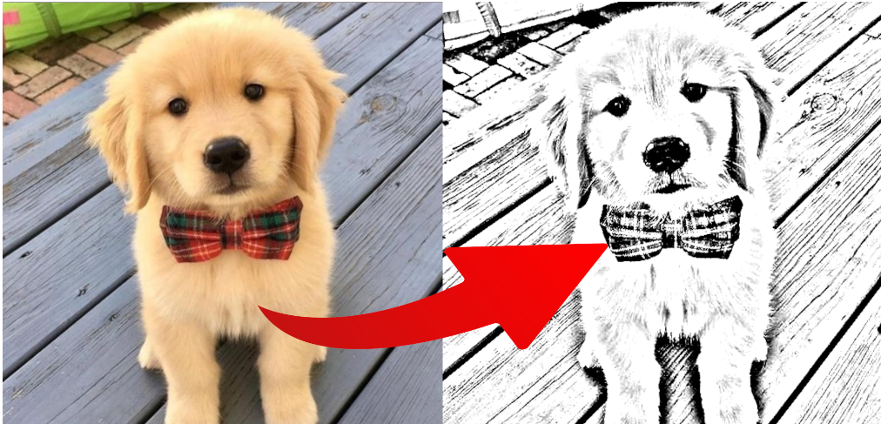
Output
1. Image to sketch

Slide 9

Output
1. Image Recognition

Slide 10
Conclusion
I would like to conclude that, it is emmensive learning experience while preparing the project. This is achieved through an easy to use graphical interface python libraries like tkinter, matplotlib,etc. The main motive behind the project is to improve human computer interaction by developing an approach to help people by converting their different images into a beautiful sketch and also helps to recognize the image. A good user interface is provided to the user to upload a input image and receive related output images.

Slide 11


